Slide 1

Learn to Fly – A Look into the Data of Flight Delays
Final Project by: Matt Beirne, Kyle Burks, Charles Phillips, and Chavell Scott

Slide 2

Project Proposal
Objective: To build a data model the provides insight into predicting the likelihood of a flight being delayed.

Slide 3
Roadblocks
Accuracy
So much data (Over 56k rows just for January)
How to slice it?

Slide 4

Our toolkit
Pandas
SQL
Mongo DB
Tableau
HTML
Excel (initial data cleaning)

Slide 5
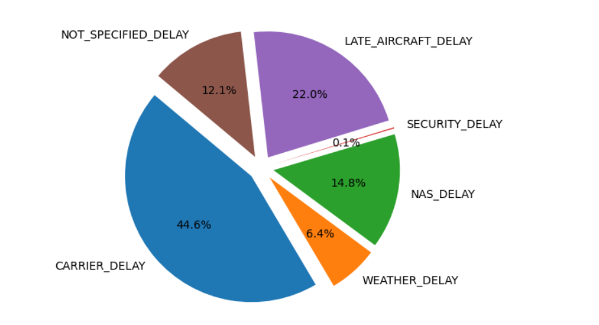
Frequency of delay types

Slide 6
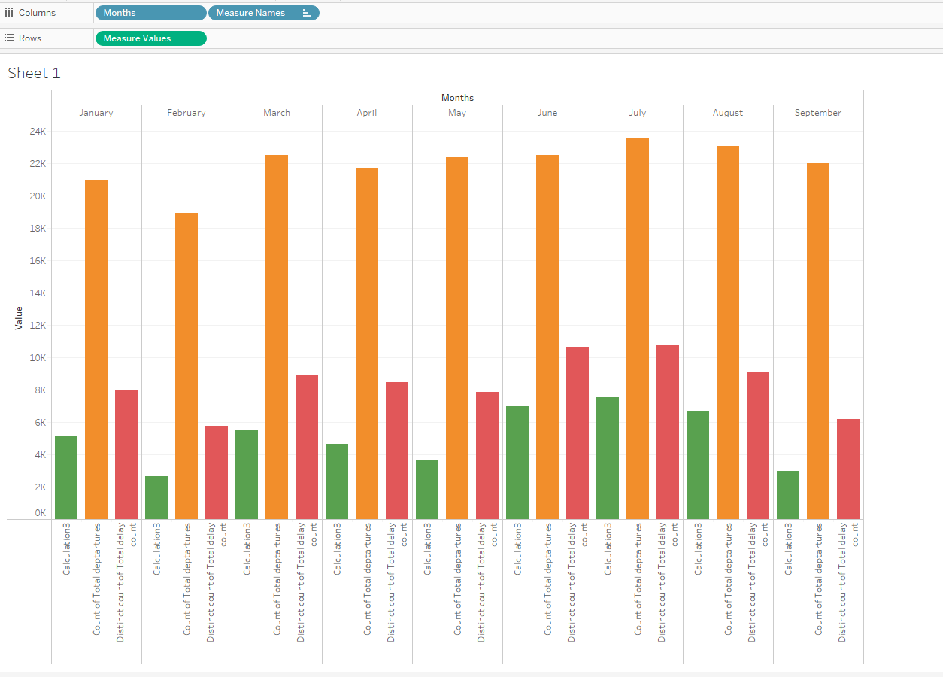
Summary of delays by month
Green – Time of all delays (in hours)
Orange – Count of total departures
Red – Total number of delays

Slide 7
Heat map of delayed destinations
Click Here for Heat Map

